Slide 1

Data Exploration

Slide 2
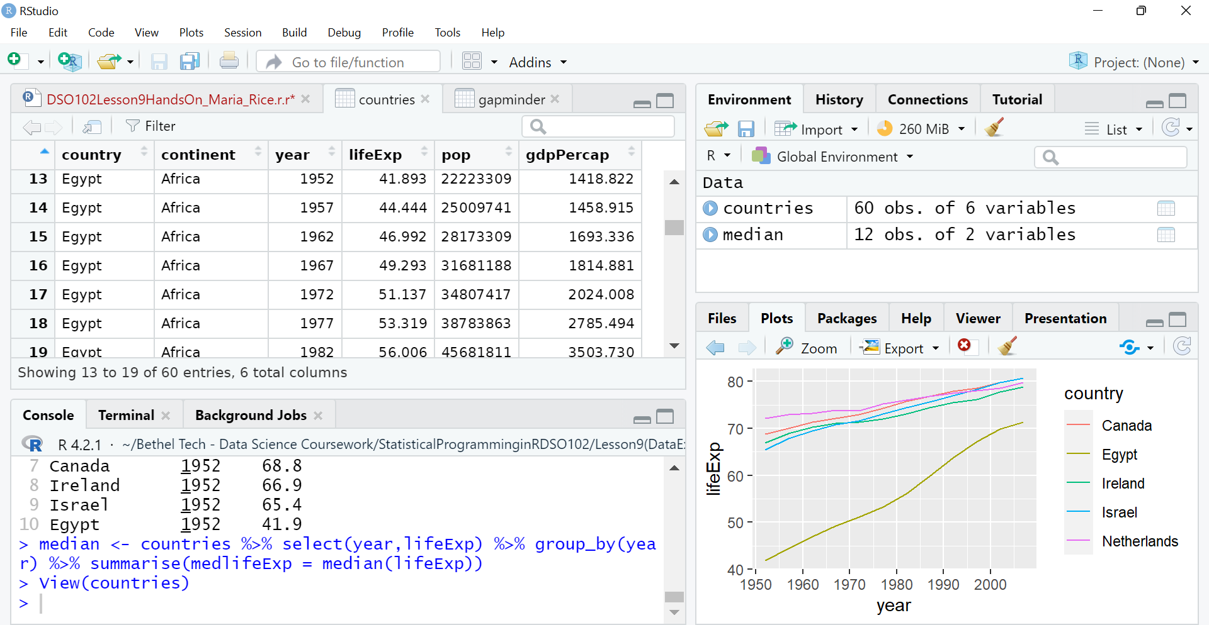
Lowest GDP in 1952 (Egypt)

Slide 3
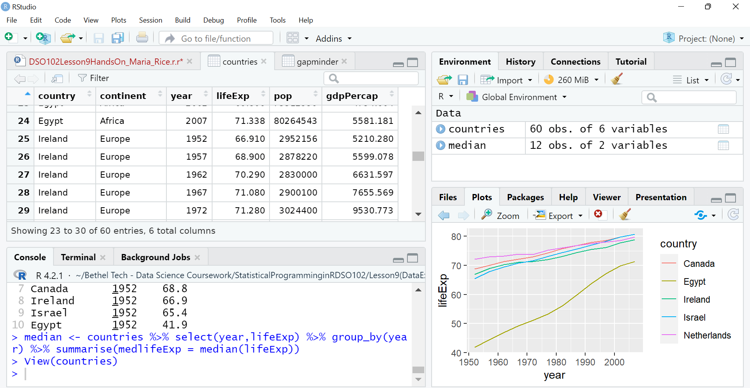
Lowest GDP in 2007 (Egypt)

Slide 4
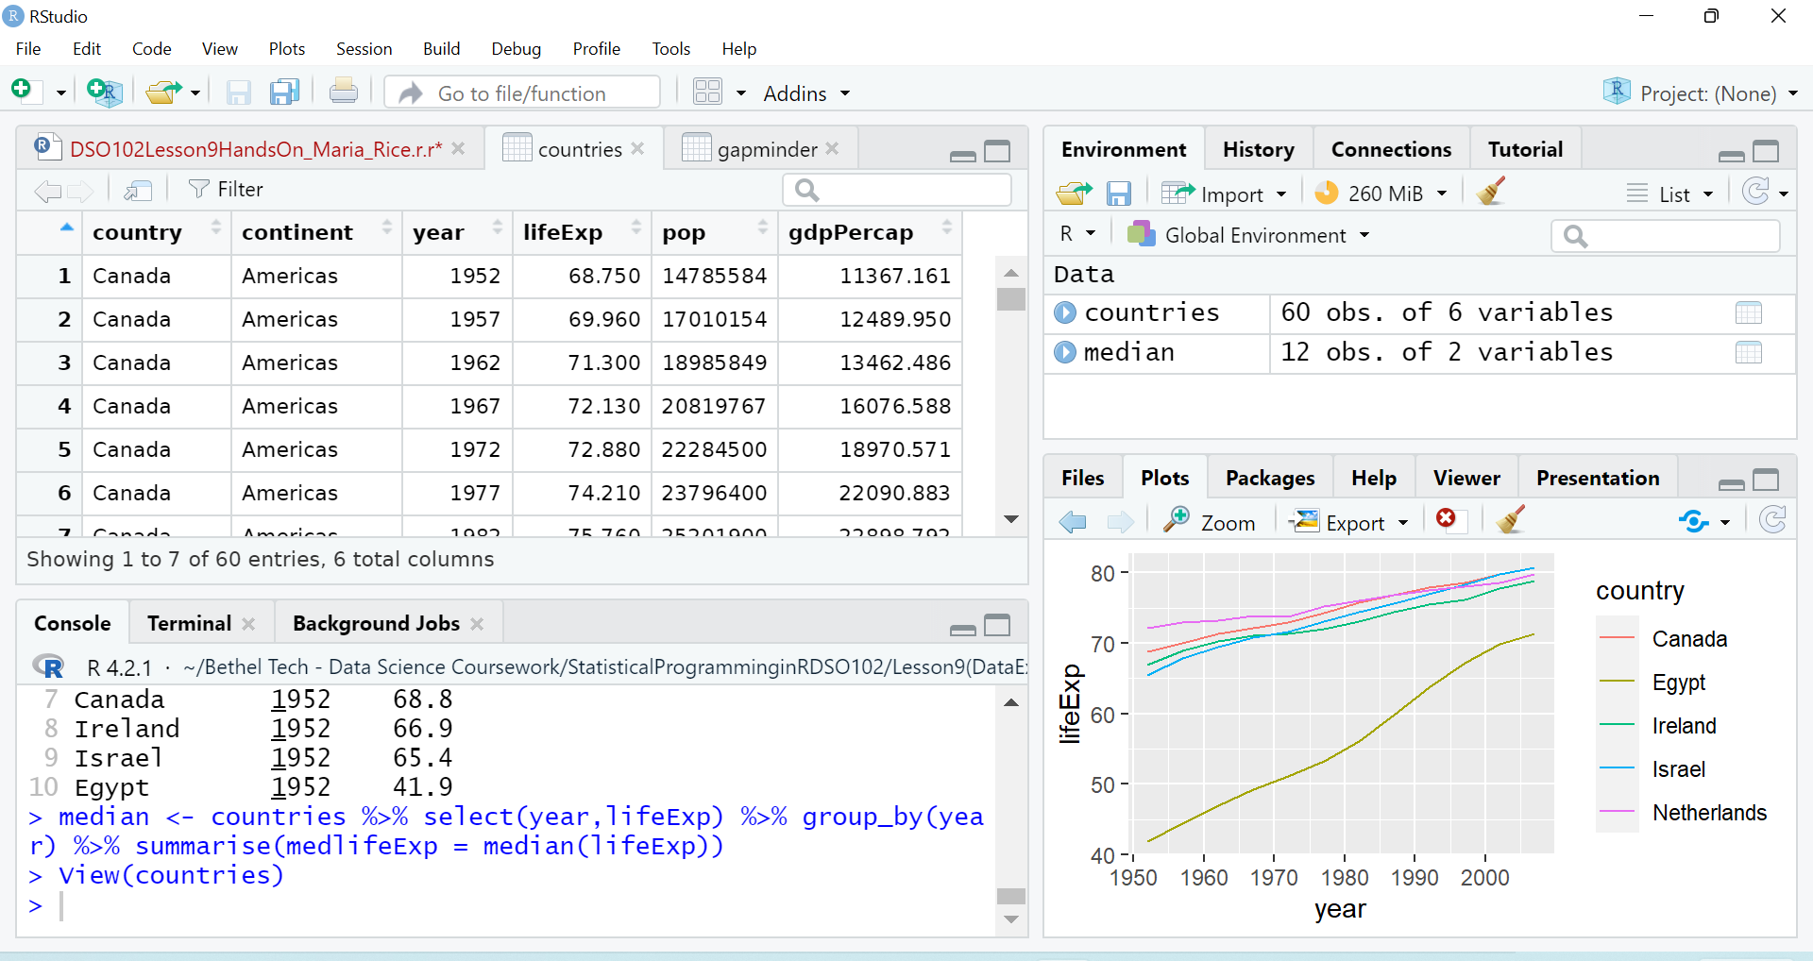
Highest GDP in 1952 (Canada)

Slide 5
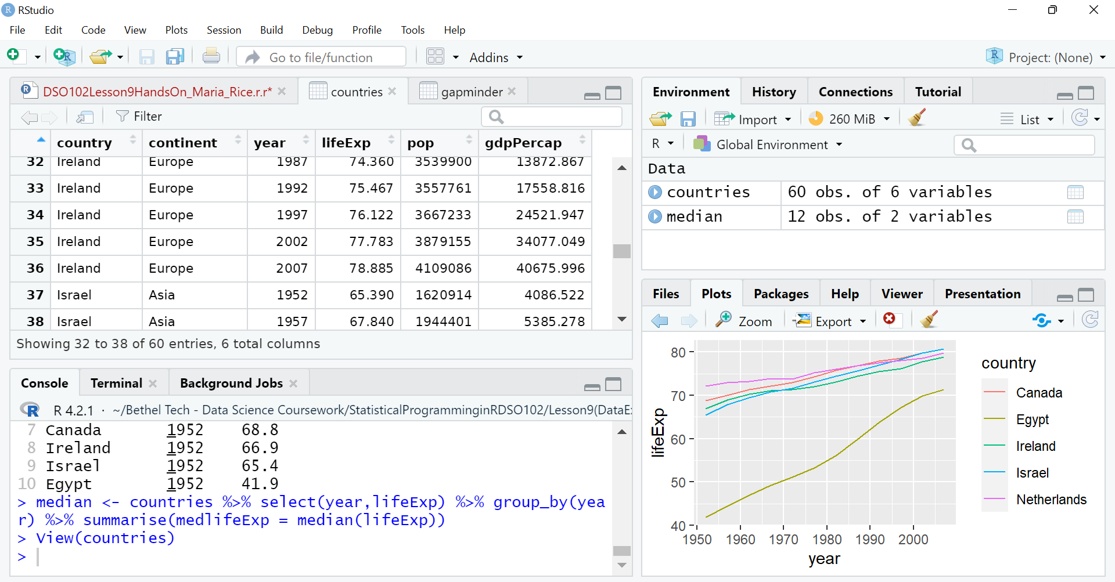
Highest GDP In 2007 (Ireland)

Slide 6
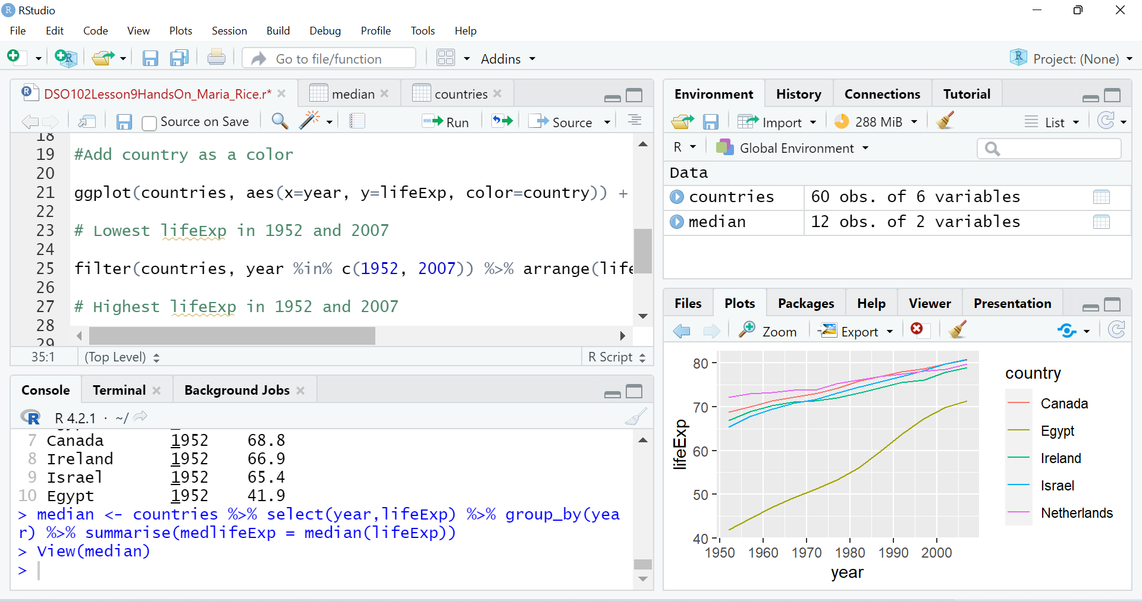
Variations in life expectancy between countries In this data set Canada, Ireland, Israel, and Netherlands have similar life expectancies throughout the years. Egypt appears to have started out on a very low end reaching almost as high as the other four countries in later years. (I am curious as to why Egypt is so different and how it got from “A” to “B”, what the causes were, and what or who was involved)

Slide 7
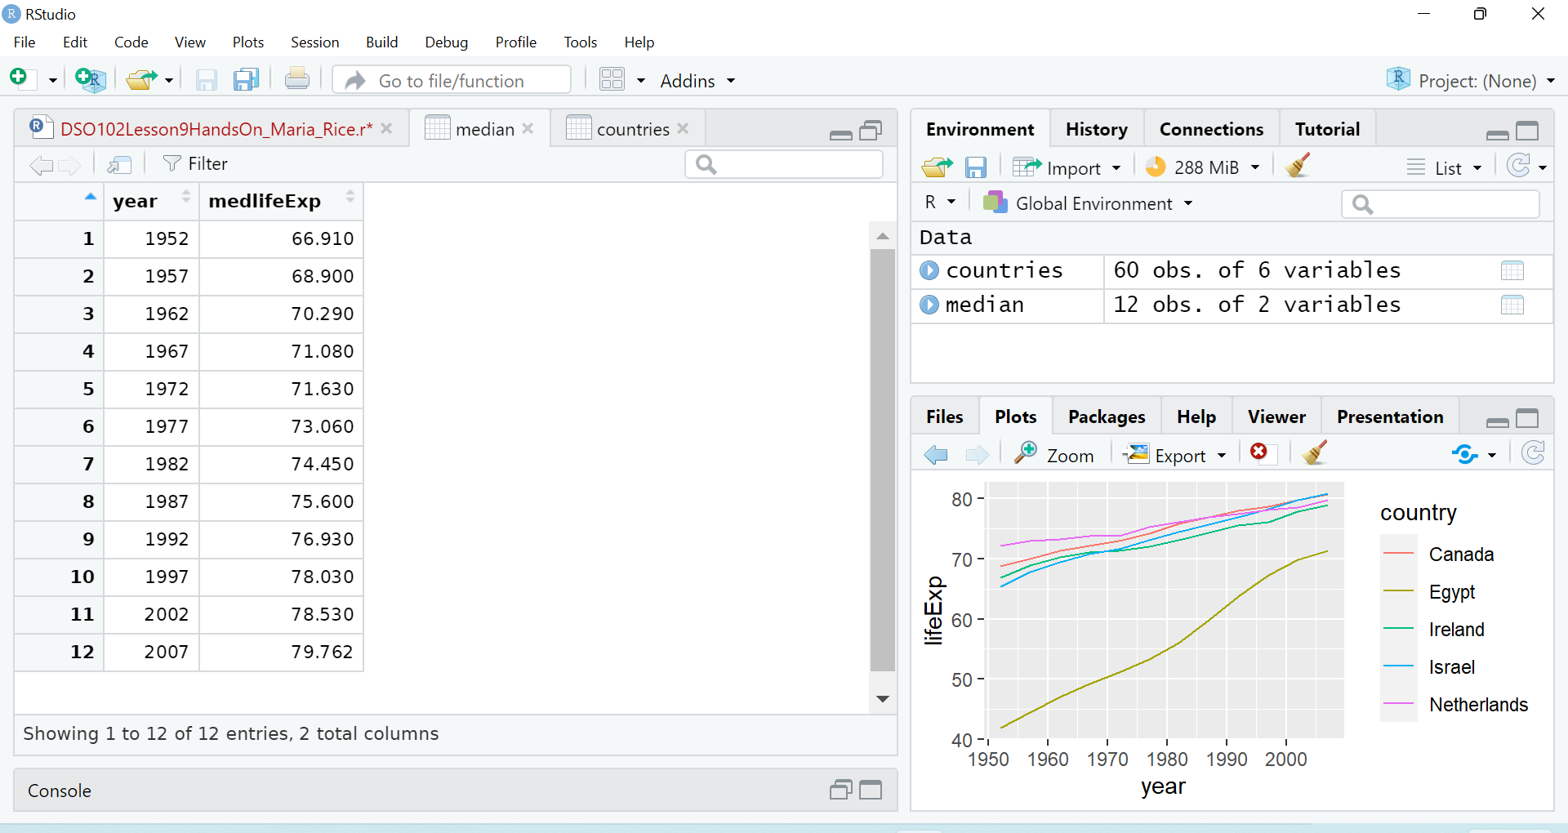
Median of lifeExp for each year From what I am observing in all 5 countries I chose, the years above life expexctancy are 1957-2007. I may be reading it wrong or don’t even have the right function. We talked about this in our meet tonight and I tried adding in different variables but none of them worked.

